Slide 1
Tech Tools for TEM 4.0
Kimberly Scott
Technology Training Specialist

Slide 2
To follow along with this presentation go to…..
thescottspot.weebly.com/resources

Slide 3
Teach 1 Objective Driven Lessons

Slide 4
Mindmeister
T1 Objective Driven Lessons
Notes:
http://www.mindmeister.com/

Slide 5
Teach 2 Explain Content

Slide 6
Story Jumper
T2 Explain Content
Cartoon Strips
Notes:
StoryJumper- http://www.storyjumper.com/
Cartoon Strips- Toon Doo http://www.toondoo.com/

Slide 7
T2 Explain Content
Storyboards
Notes:
Meme Generator- IMG Flip https://imgflip.com/memegenerator
Storyboard That- http://www.storyboardthat.com/

Slide 8
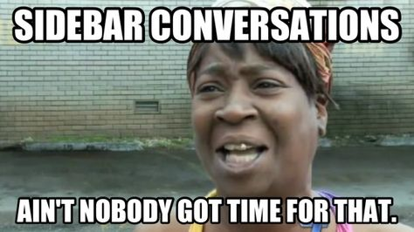
Memes
T2 Explain Content
Notes:
Meme Generator- IMG Flip https://imgflip.com/memegenerator
Storyboard That- http://www.storyboardthat.com/

Slide 9
Teach 3 Challenging Work

Slide 10
Choice Boards
T3 Challenging Work
Notes:
Choice Board- https://daretodifferentiate.wikispaces.com/Choice+Boards
Tech Choice Boards- http://chirc.weebly.com/technology-choice-boards.html

Slide 11
Teach 4 Engagement Strategies

Slide 12
Voki
T4 Engage-ment Strategies
Word Cloud
Notes:
Voki- http://www.voki.com/
Word Cloud- http://www.abcya.com/word_clouds.htm
Wordle- http://www.wordle.net/

Slide 13
Fakebook
T4 Engage-ment Strategies
Text Messages
Notes:
Fakebook- http://www.classtools.net/FB/home-page
Text Message- iPhone- http://www.fakephonetext.com/ and http://www.fakeiphonetext.com/
Android- http://fakeandroidtext.com/

Slide 14
Teach 5 Higher Level Thinking Skills

Slide 15
A Pyramid of Resources!
T5 Higher Level Thinking Skills
Notes:
Pyramid of Web 2.0 Tools for Blooms- http://www.casdonline.org/education/components/scrapbook/default.php?sectionid=2365&/#revised (scroll all the way to the bottom of the page for links)
Higher Order Thinking Skils- http://www.robeson.k12.nc.us/domain/4057

Slide 16
Teach 6 Checks for Understanding

Slide 17
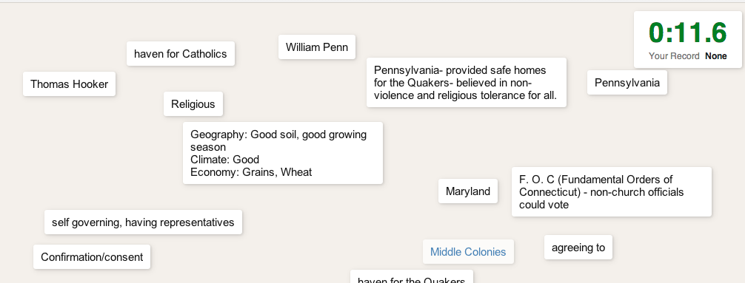
Quizlet
T6 Checks for Understanding
Plikers
Notes:
Quizlet- http://quizlet.com/
Plikers- https://www.plickers.com/

Slide 18
Poll Everywhere
Exit Ticket
T6 Checks for Understanding
Notes:
Poll Everywhere- http://www.polleverywhere.com/
Exit Ticket- http://exitticket.org/

Slide 19
Teach 7 Instructional Time

Slide 20
Online Stop Watch
T7 Instructional Time
Notes:
Online Stop Watch- http://www.online-stopwatch.com/

Slide 21
Contact Information
Kimberly Scott
Technology Training Specialist
scottks@scsk12.org
901-416-4217

